Slide 1


HUM 102 Report Writing Skills
Lecture 28

Slide 2

Previous Lecture
Punctuation Marks
Run-On Sentences
Determiners

Slide 3




Tenses
Verb Tenses
Verb: Indicates action, occurrence, and state of being
Tense: Placement of a verb in time
Three major types of verb tenses categorized according to time frame each extended further into sub-categories:
Present Tense
Past Tense
Future Tense

Slide 4
Tenses
Present: Simple/Indefinite Tense [1/2]
To describe action, event, or condition occurring in present/at the moment
Sadan waits patiently while Talal books the tickets
To express general truths such as scientific facts
Rectangles have four sides.
To indicate a habitual action, event, or condition
Shahkar goes to The Mall every Thursday evening

Slide 5
Tenses
Present: Simple/Indefinite Tense [2/2]
Used when writing about works of art
Lear rages against the silence of Cordelia and only belatedly realizes that she, not her more vocal sisters, loves him.
To refer to a future event when used in conjunction with an adverb/ adverbial phrase
The doors open in 10 minutes.
Classes end next week.
The lunar eclipse begins in exactly 43 minutes.

Slide 6
Tenses
Present: Progressive/Continuous Tense
To emphasize the continuing nature of act, event, or condition
Ahmad is looking for his keys.
Uzma is working on an assignment.
Occasionally used to refer to a future event when used in conjunction with an adverb/ adverbial phrase
The doors are opening in 10 minutes.
Classes are ending next week.

Slide 7
Tenses
Present: Perfect Tense
To describe an action that began in past and continues or has just completed at the moment of utterance
Used to suggest that past action still has an effect on something happening in present
They have not delivered the documents we need.
The health department has decided that all high school students should be immunized against meningitis.
Bilawal has dreamt about frogs sitting in trees every night this week.

Slide 8
Tenses
Present: Perfect Progressive/Continuous Tense
To describe an action, event or condition that began in past and continues into the present
Stress is on the on-going nature of action, event, condition
They have been publishing this comic book for ten years.
That dog has been barking for three hours.

Slide 9
Tenses
Past: Simple/Indefinite Tense
To describe an action, event or condition that occurred in past
Before the moment of speaking or writing
I ate an apple.
He worked in a factory.
They met a friend in the market.

Slide 10
Tenses
Past: Progressive/Continuous Tense
To describe actions ongoing in past
Actions take place in a specific time frame
No immediate or obvious connection to the present
Continuous event or action completed before the time of speaking/ writing
The cat was walking along the tree branch.
The archivists were eagerly waiting for the delivery of the former prime minister's private papers.

Slide 11
Tenses
Past: Perfect Tense
Actions that took place and were completed in past
Used to emphasize that one action, event or condition ended before another action, event, condition began
Miriam arrived at 5:00 p.m. but Mr. Whitaker had closed the store.
We ate supper after we located the restaurant that Mehmood had recommended.
The elephant had eaten all the hay so we fed it oats for a week.
The heat wave had lasted three weeks.

Slide 12
Tenses
Past: Perfect Progressive/Continuous Tense
To indicate that a continuing action in the past began before another past action began or interrupted the first action
The toddlers had been running around the school yard for ten minutes before the teachers shooed them back inside.
We had been talking about repainting the front room for three years and last night we finally bought the paint.
A construction crew had been digging one pit after another in the middle of my street for three days before they found the water main.
The chef's assistant had been chopping vegetables for several minutes before he realized that he had minced his apron strings.

Slide 13
Tenses
Future: Simple/Indefinite Tense
Used to refer to actions, events, or conditions which would occur after the act of speaking/ writing
They will meet us at the newest café in the market.
Babar will call you tomorrow with details about the agenda.
At the feast, we will eat heartily.

Slide 14
Tenses
Future: Progressive/Continuous Tense
To describe actions ongoing in the future.
To refer to continuing action that will occur in the future.
Zeeshan will be working on the computer system for the next two weeks.
The selection committee will be meeting every Wednesday morning.

Slide 15
Tenses
Future: Perfect Tense
To refer to an action that will be completed sometime in the future before another action takes place
The surgeon will have operated on 6 patients before she attends a luncheon meeting.
By the time you get back from the corner store, we will have finished writing the thank you letters.

Slide 16
Tenses
Future: Perfect Progressive/Continuous Tense
Used rarely
To indicate a continuing action that will be completed at some specified time in the future
I will have been studying Greek for three years by the end of this term.
By the time the meeting is over, the committee will have been arguing about which candidate to interview for three hours.

Slide 17

Subject Verb Agreement
Rules and Guidelines
Basic Rule
Singular subject takes a singular verb
Plural subject takes a plural verb
Rule 1
Two singular subjects connected by or or nor require a singular verb
My aunt or my uncle is arriving by train today.
Rule 2
Two singular subjects connected by either/or or neither/nor require a singular verb as in Rule 1
Neither Juan nor Carmen is available.
Either Kiana or Casey is helping today with stage decorations.

Slide 18
Subject Verb Agreement
Rules and Guidelines
Rule 3
When I is one of the two subjects connected by either/or or neither/nor, put it second and follow it with the singular verb am
Neither she nor I am going to the festival.
Rule 4
When a singular subject is connected by or or nor to a plural subject, put the plural subject last and use a plural verb
The serving bowl or the plates go on that shelf.

Slide 19
Subject Verb Agreement
Rules and Guidelines
Rule 5
When a singular and plural subject are connected by either/or or neither/nor, put the plural subject last and use a plural verb
Neither Jenny nor the others are available.
Rule 6
Use a plural verb with two or more subjects when they are connected by and
A car and a bike are my means of transportation.

Slide 20
Subject Verb Agreement
Rules and Guidelines
Rule 7
Sometimes the subject is separated from the verb by words such as along with, as well as, besides, or not
Ignore these expressions
Focus on the subject which precedes these expressions
The politician, along with the newsmen, is expected shortly.
Excitement, as well as nervousness, is the cause of her shaking.

Slide 21
Subject Verb Agreement
Rules and Guidelines
Rule 8
Pronouns each, everyone, every one, everybody, anyone, anybody, someone, and somebody are singular and require singular verbs.
Every one of the cakes is gone.
Each of the girls sings well.
Note: Everyone is one word when it means everybody. Every one is two words when the meaning is each one.

Slide 22
Subject Verb Agreement
Rules and Guidelines
Rule 9
In case of words indicating portions (percent, fraction, part, majority, some, all, none, remainder, and so forth), use the verb in accordance with the noun being used in the of phrase
Focus on the object of preposition ‘of’
Fifty percent of the pie has disappeared.
Fifty percent of the pies have disappeared.
One-third of the city is unemployed.
One-third of the people are unemployed.
None of the garbage was picked up.
None of the sentences were punctuated correctly.

Slide 23
Subject Verb Agreement
Rules and Guidelines
Rule 10
The expression, The number, is followed by a singular verb
The expression, A number, is followed by a plural verb
The number of people we need to hire is thirteen.
A number of people have written in about this subject.
Rule 11
Either and Neither as subjects take a singular verb
Neither of them is available to speak right now.
Either of us is capable of doing the job.

Slide 24
Subject Verb Agreement
Rules and Guidelines
Rule 12
In sentences beginning with here or there, the subject follows the verb
There are four hurdles to jump.
There is a high hurdle to jump.
Rule 13
Singular verb with sums of money or periods of time
Ten dollars is a high price to pay.
Five years is the maximum sentence for that offense.

Slide 25
Subject Verb Agreement
Rules and Guidelines
Rule 14
With pronouns such as who, that or which, use the verb according to the noun directly in front of these pronouns
Salma is the scientist who writes the reports.
He is one of the men who do the work.
Rule 15
Collective nouns such as team and staff may be either singular or plural depending on their use in a sentence
The staff is in a meeting.
The staff are in disagreement about the findings (staff members).

Slide 26
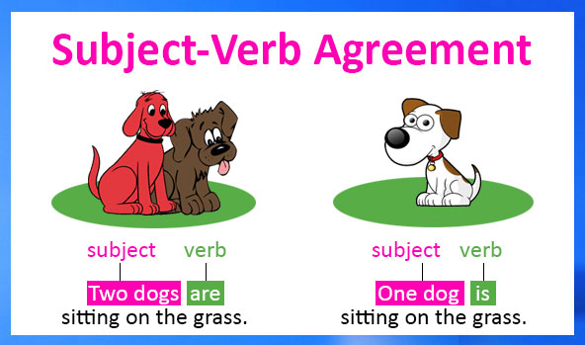
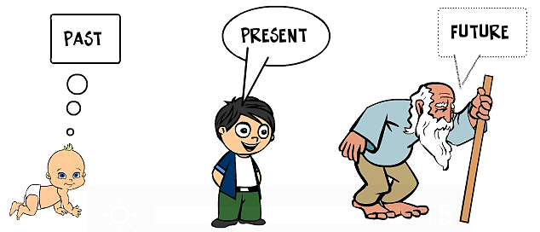
Conclusions
Tenses
Subject Verb Agreement

